Slide 1




SENTIMENT ANALYSIS - BITCOIN
BY
PATRICK BARRETT, MATT RENTNER, IRINA GASNIKOVA
AND
JEMIMA CHELLASWAMY

Slide 2
INTRODUCTION - BITCOIN
Best known cryptocurrency (encryption techniques used to secure the network).
Bitcoins are stored in digital wallet app.
Can be transacted between people via digital wallet.
Each of these transactions has been stored in public list called blockchain.
Decentralized - not controlled by the government or banks.
Can be spent anonymously, however, all transactions are recorded, and nobody know which private key belongs to who.
There are three main ways acquire Bitcoins.
Buy Bitcoins using 'real' money.
Sell things and let people pay you with Bitcoins.
Created using computer called mining.
Not widely used in retail but has lot of interests among investors.

Slide 3
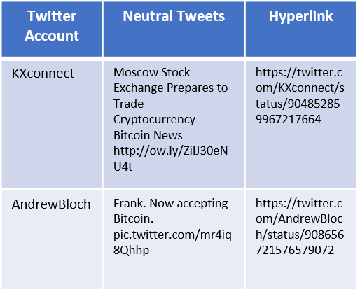
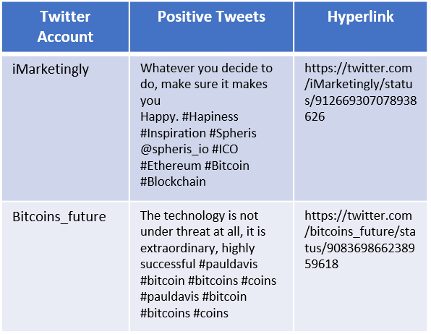
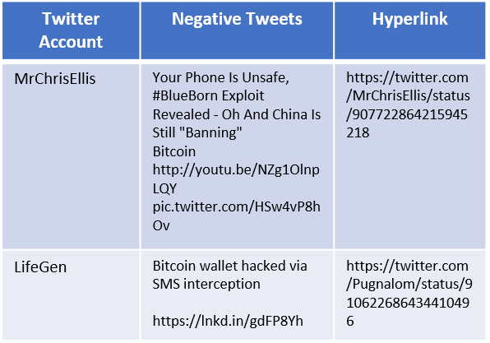
SENTIMENT ANALYSIS - BITCOIN
Cryptocurrency price for the past couple of years is very tumultuous and they are widely used for retail purchases or trading but has gained lot of investors interest in the recent years. Investors are seeking insights on digital currency data for intelligently predicting and investing. Recently sentiment analysis using digital currency data collected from social media to observe the sentiments effect on the digital currency price has gained lot of popularity.
In this data analysis we will use the sentiments from the tweets, news and bots dataset from Kaggle and analyze its correlation on bitcoin price and volume. We will also see how the volume of tweets relate to the bitcoin price and volume with an objective to gain insights on how sentiments impact the bitcoin trading.

Slide 4
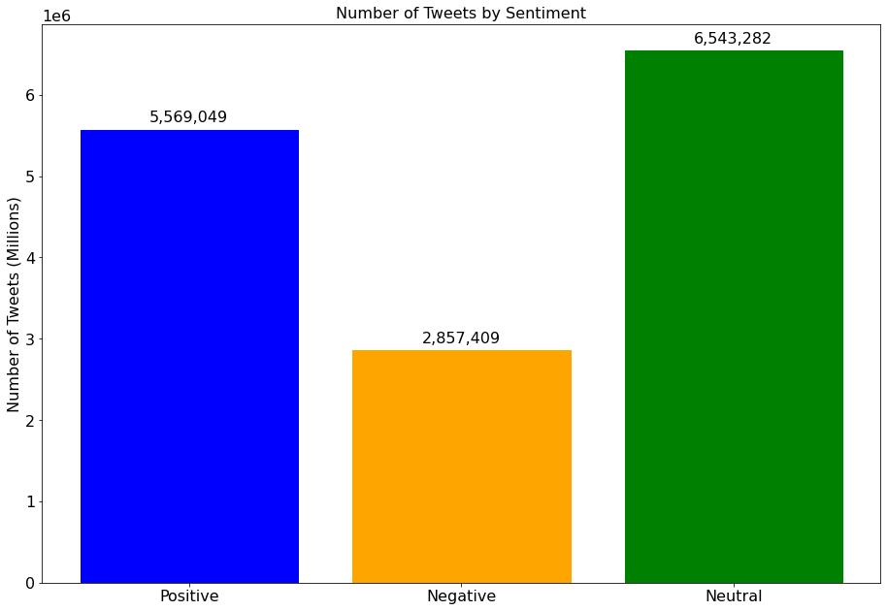
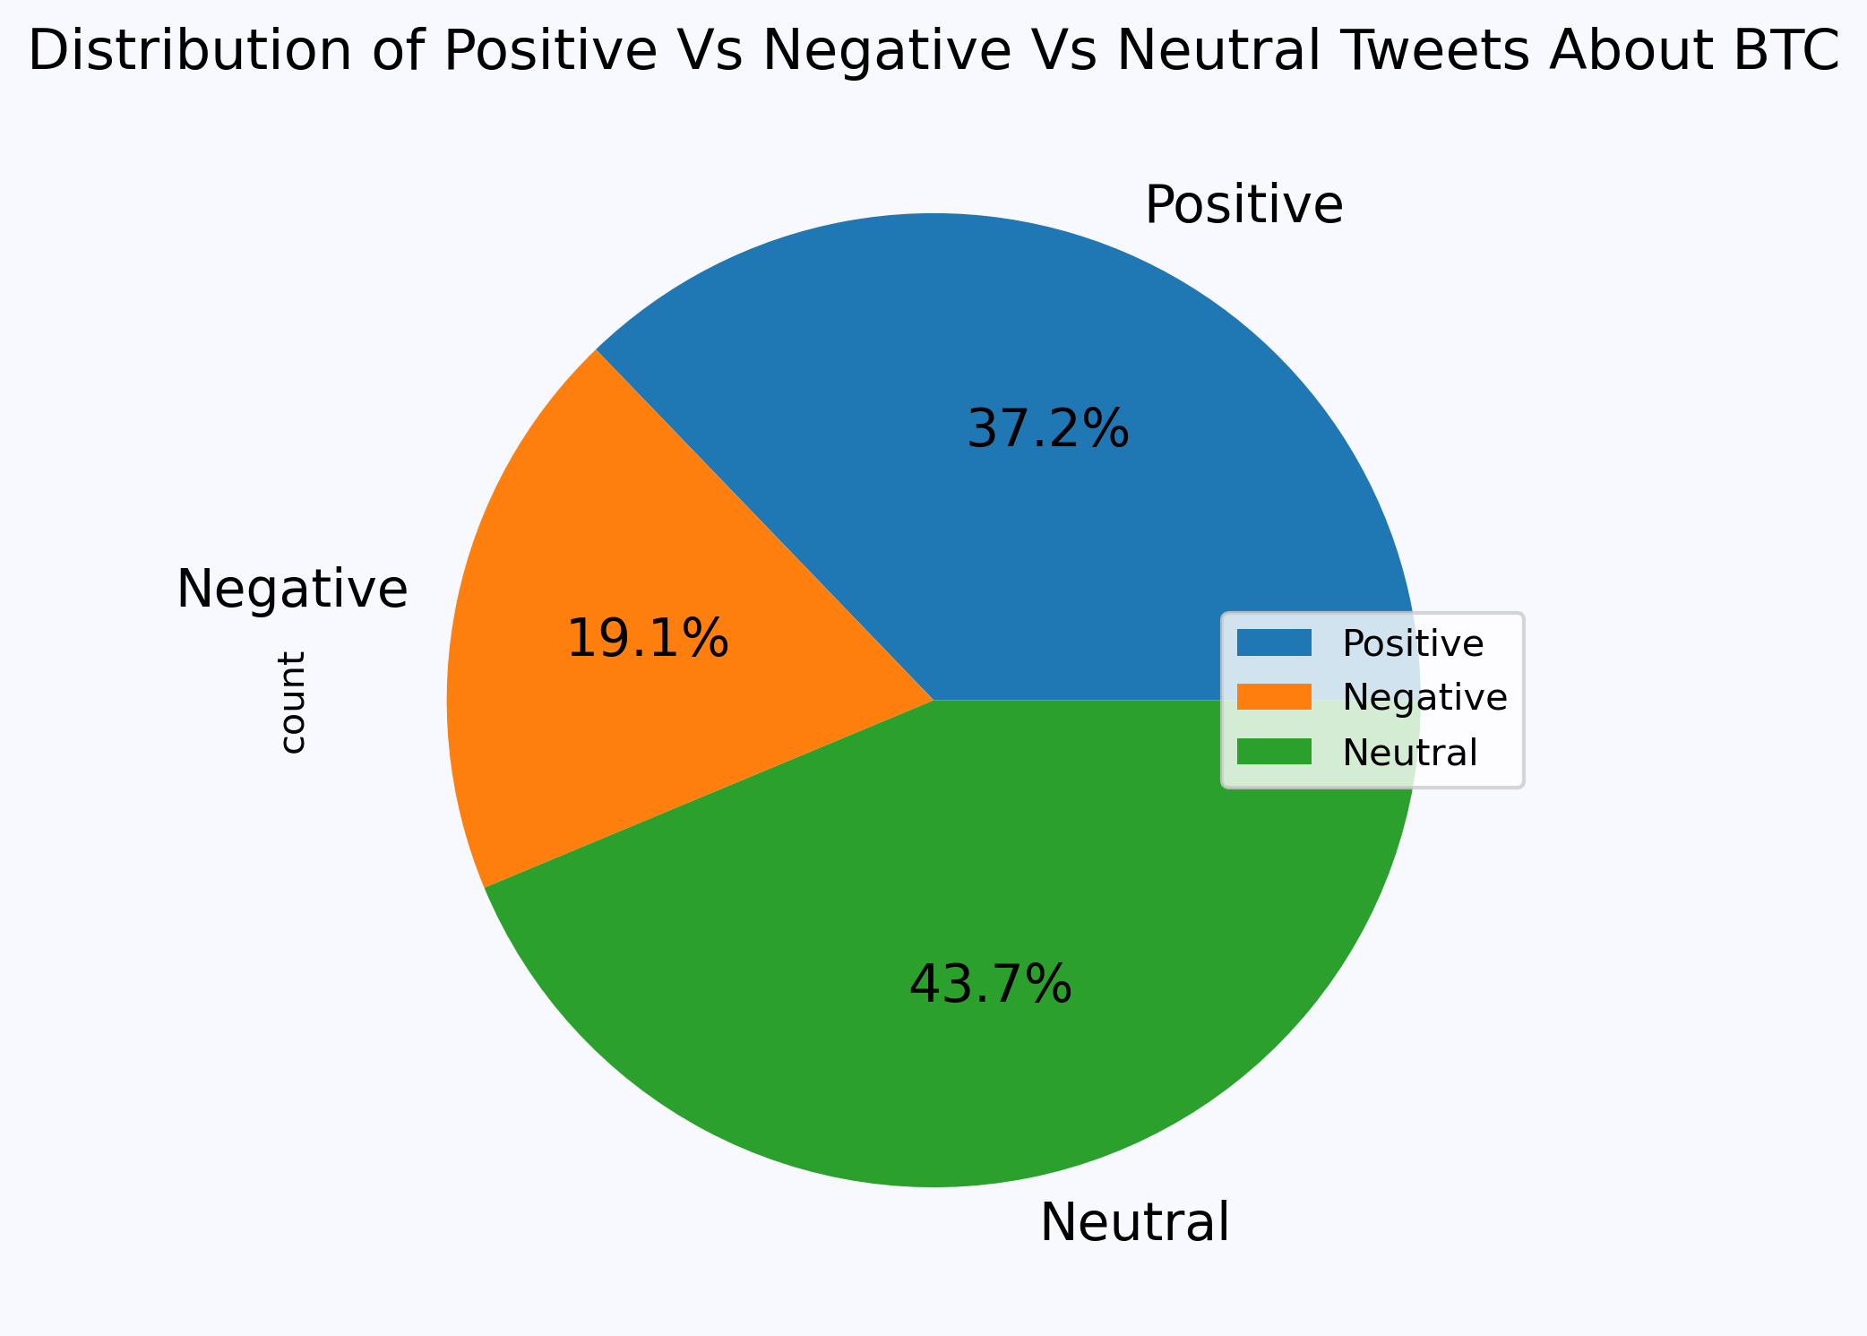
Distribution of Data
Positive Tweet – Positive Sentiment
Negative Tweet – Negative Sentiment
Neutral Tweet – Neutral Sentiment
Observations | Positive | Negative | Neutral
539 | 5,569,049 | 2,857,409 | 6,543,282

Slide 5
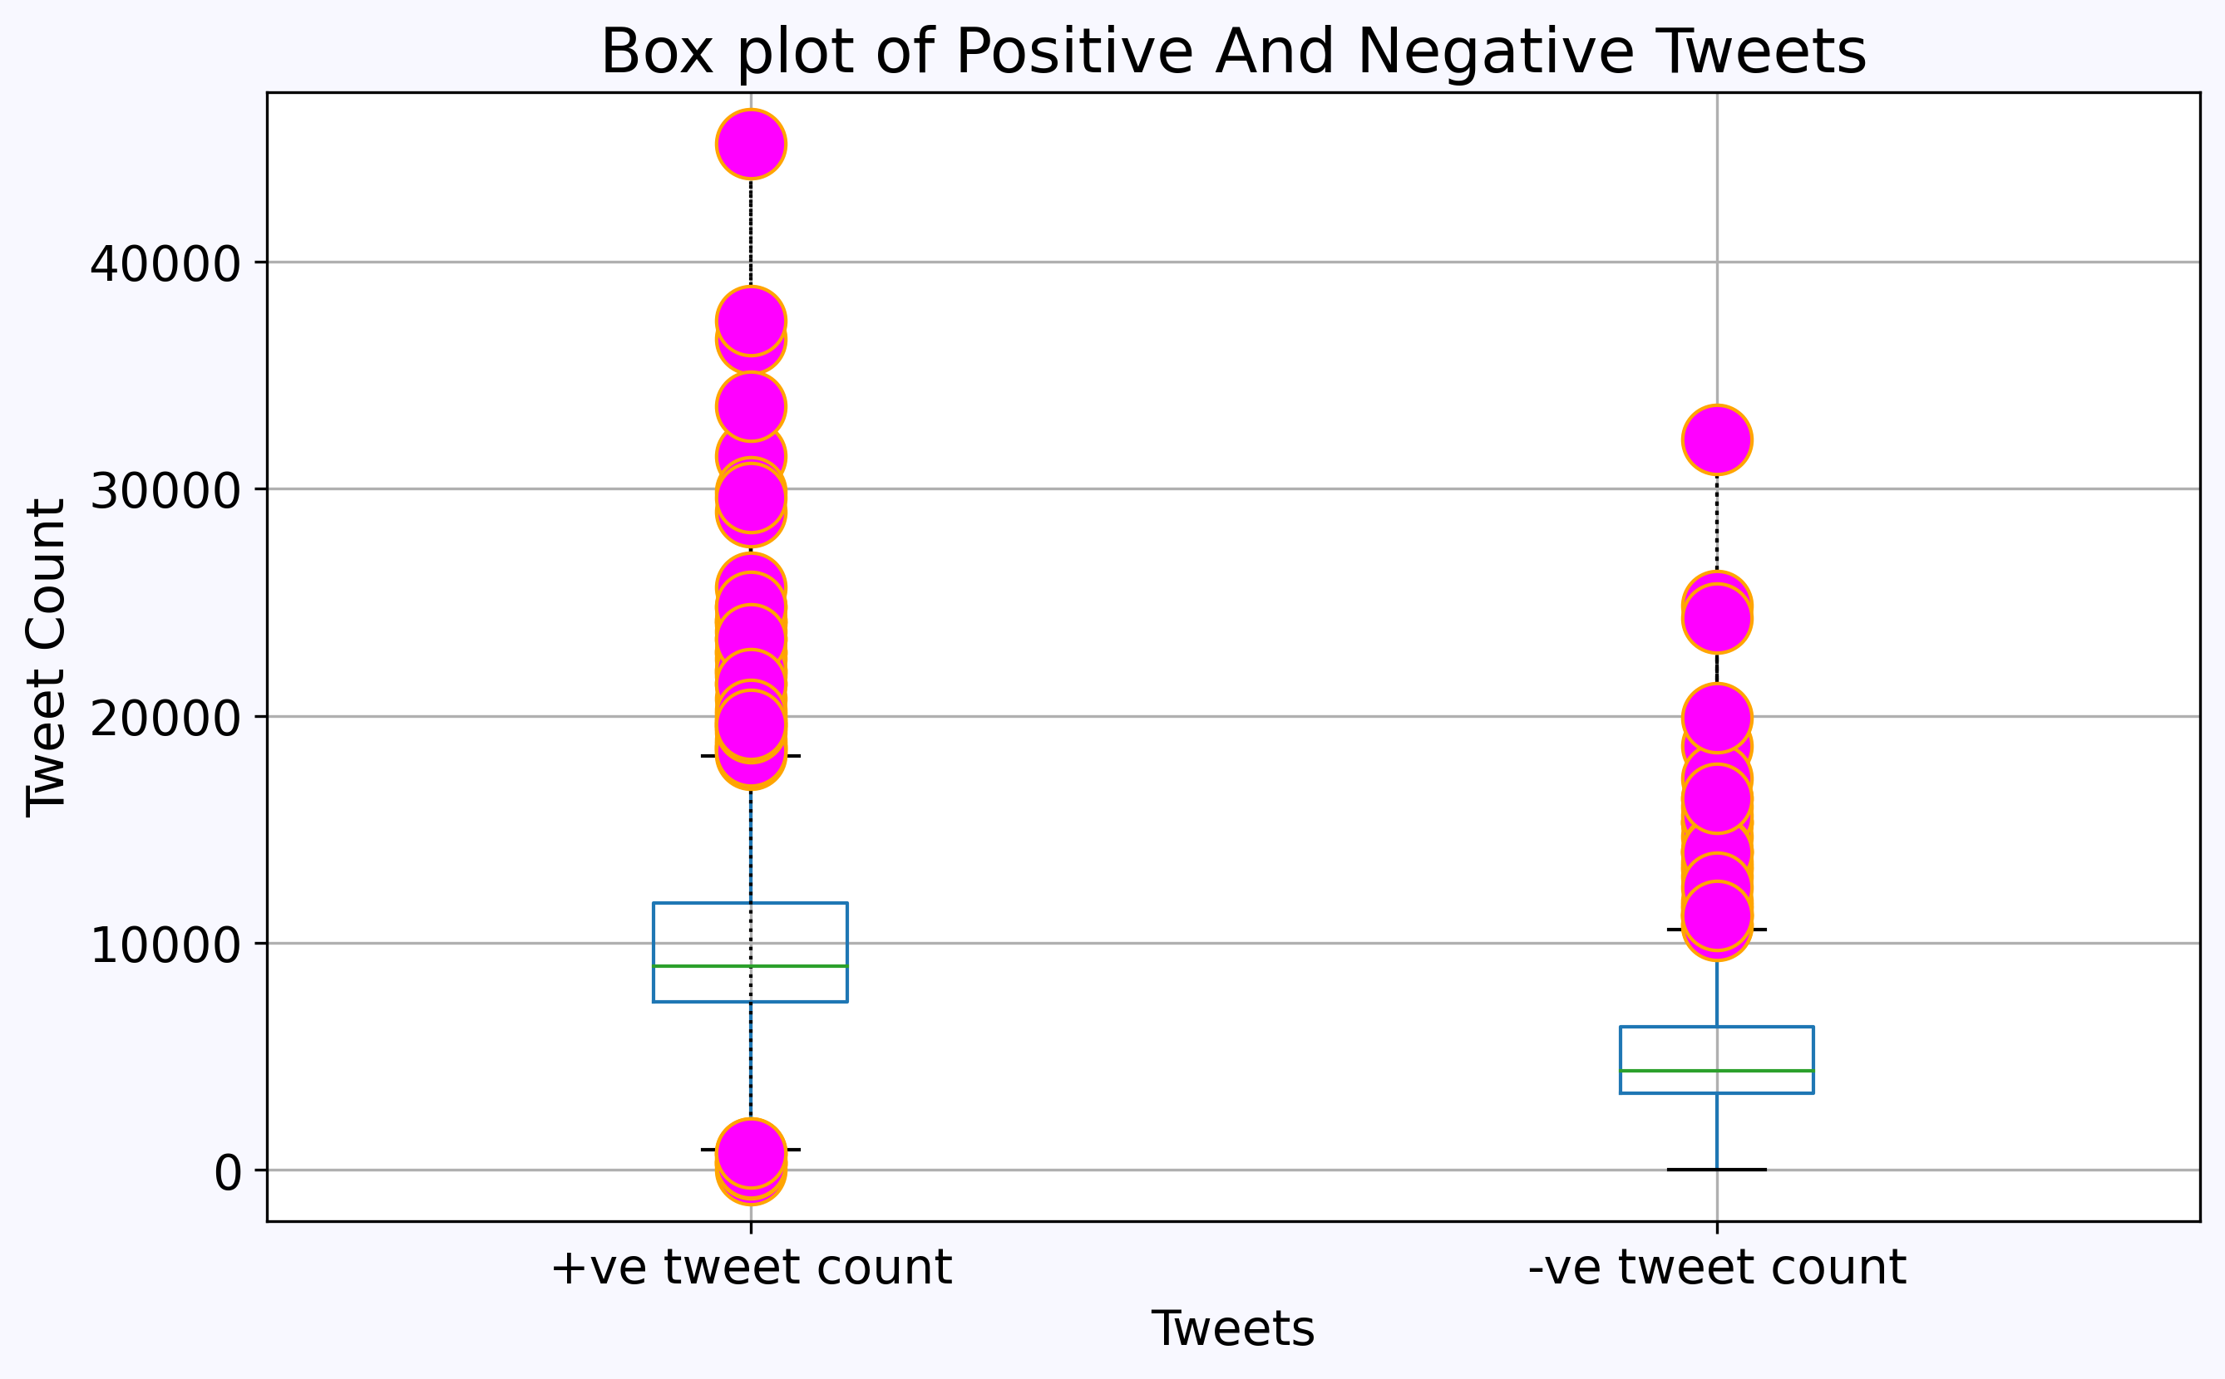
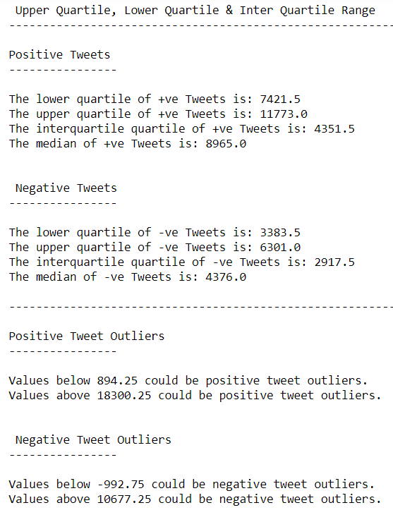
Box Plot For Positive and Negative Tweets

Slide 6
Comparing Bitcoin Price and Twitter Sentiment

Slide 7
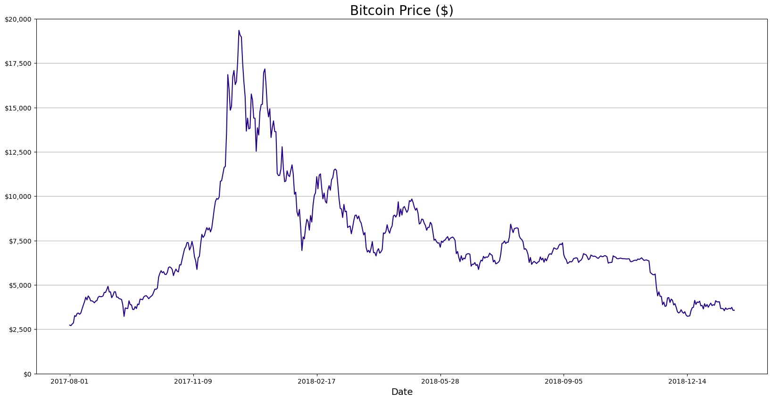
Price of Bitcoin
*Daily Prices: 08/01/2017 – 01/21/2019

Slide 8
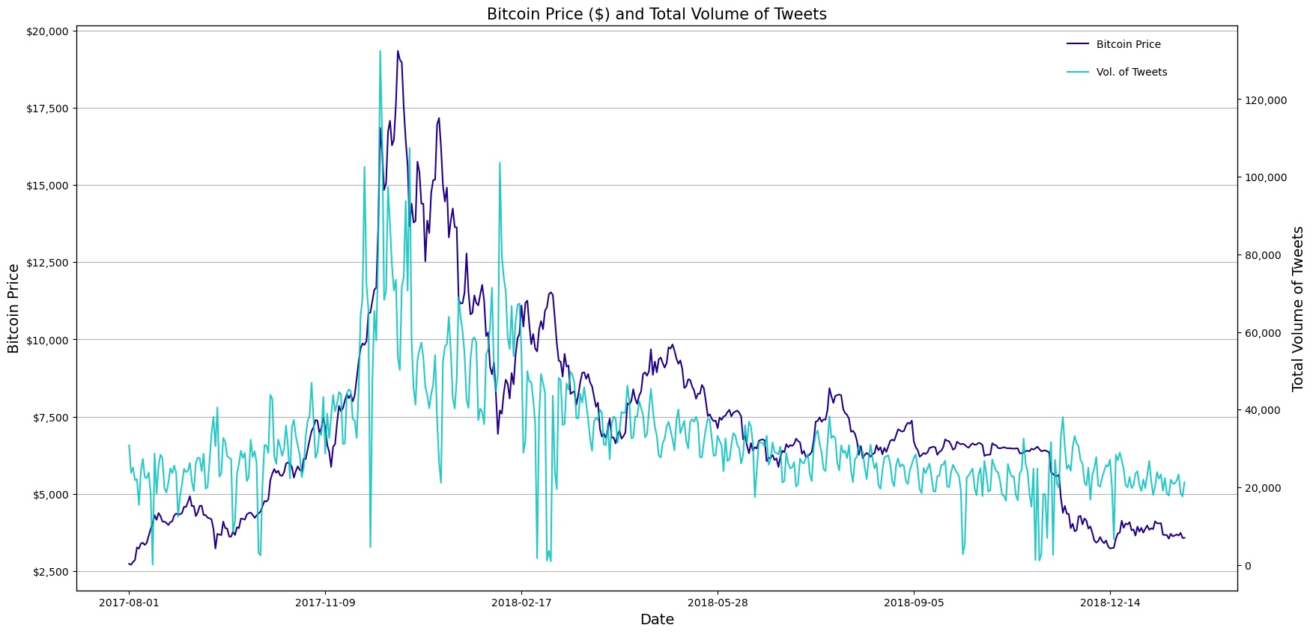
Bitcoin Price and Total Volume of Tweets
Correlation: 66.4%
*Period: 08/01/2017 – 01/21/2019

Slide 9
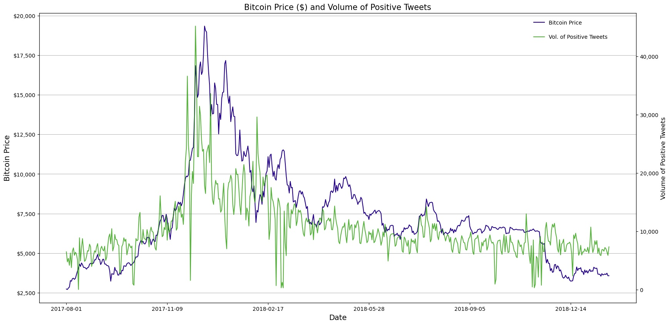
Bitcoin Price and Volume of Positive Tweets
Correlation: 69.5%
*Period: 08/01/2017 – 01/21/2019

Slide 10
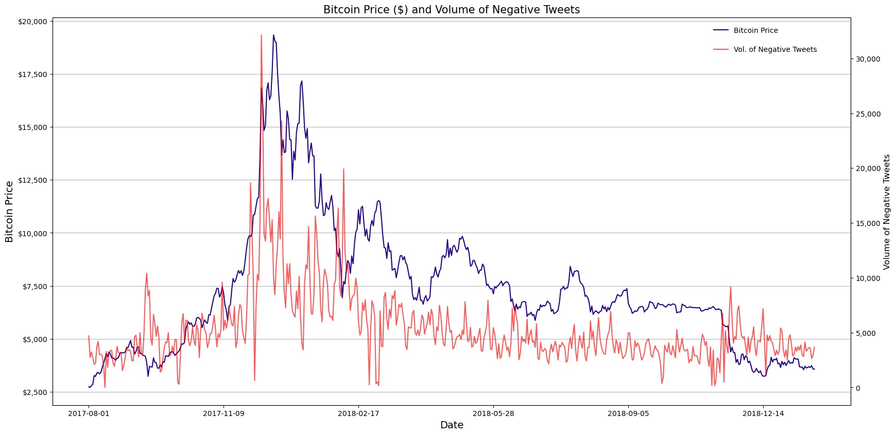
Bitcoin Price and Volume of Negative Tweets
Correlation: 60.9%
*Period: 08/01/2017 – 01/21/2019

Slide 11
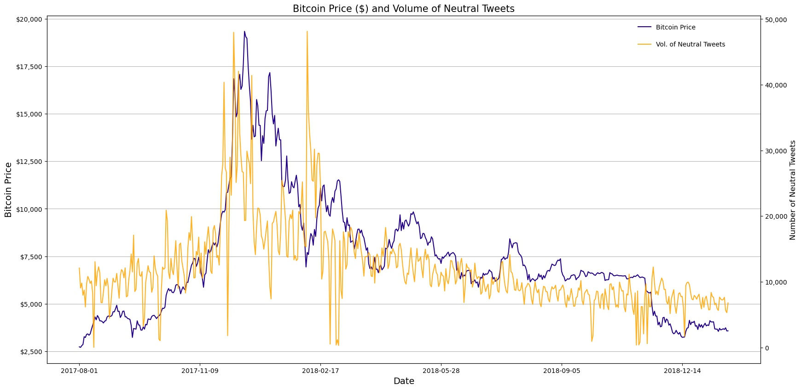
Bitcoin Price and Volume of Neutral Tweets
Correlation: 61.6%
*Period: 08/01/2017 – 01/21/2019

Slide 12
Bitcoin Price and Volume of Positive, Negative, and Neutral Tweets
*Period: 08/01/2017 – 01/21/2019
*Period: 08/01/2017 – 01/21/2019
*Period: 08/01/2017 – 01/21/2019

Slide 13
Comparing Bitcoin Volume and Twitter Sentiment

Slide 14
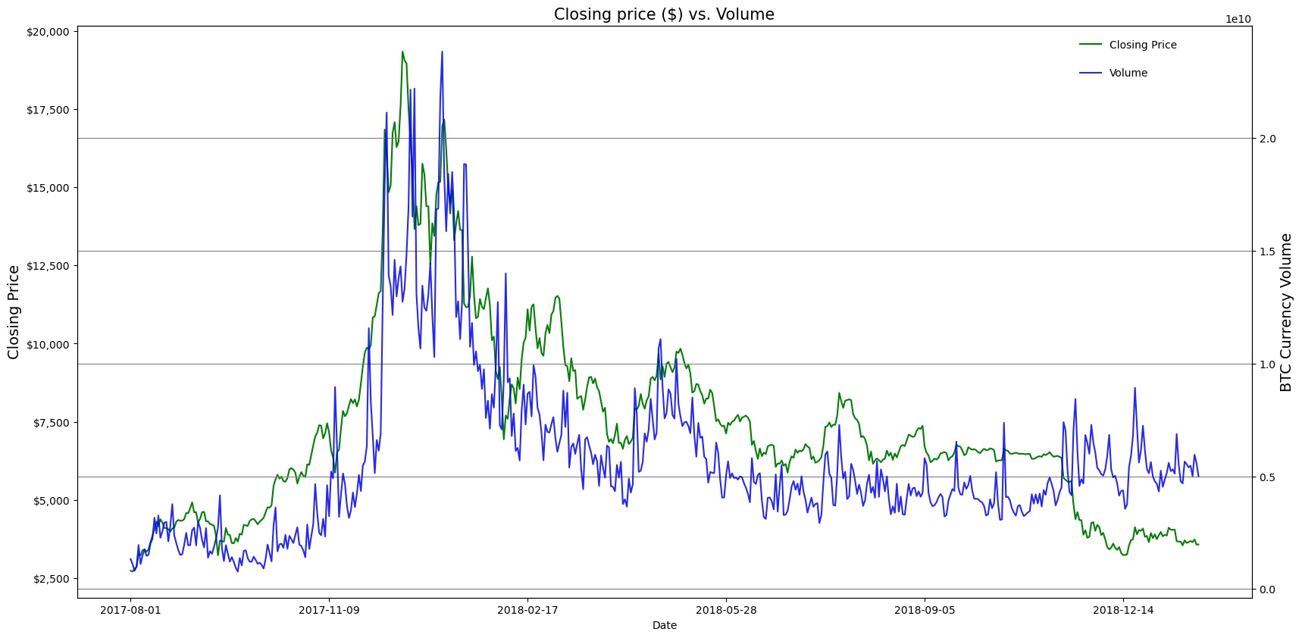
Bitcoin Volume and Closing Price
Correlation: 81%

Slide 15
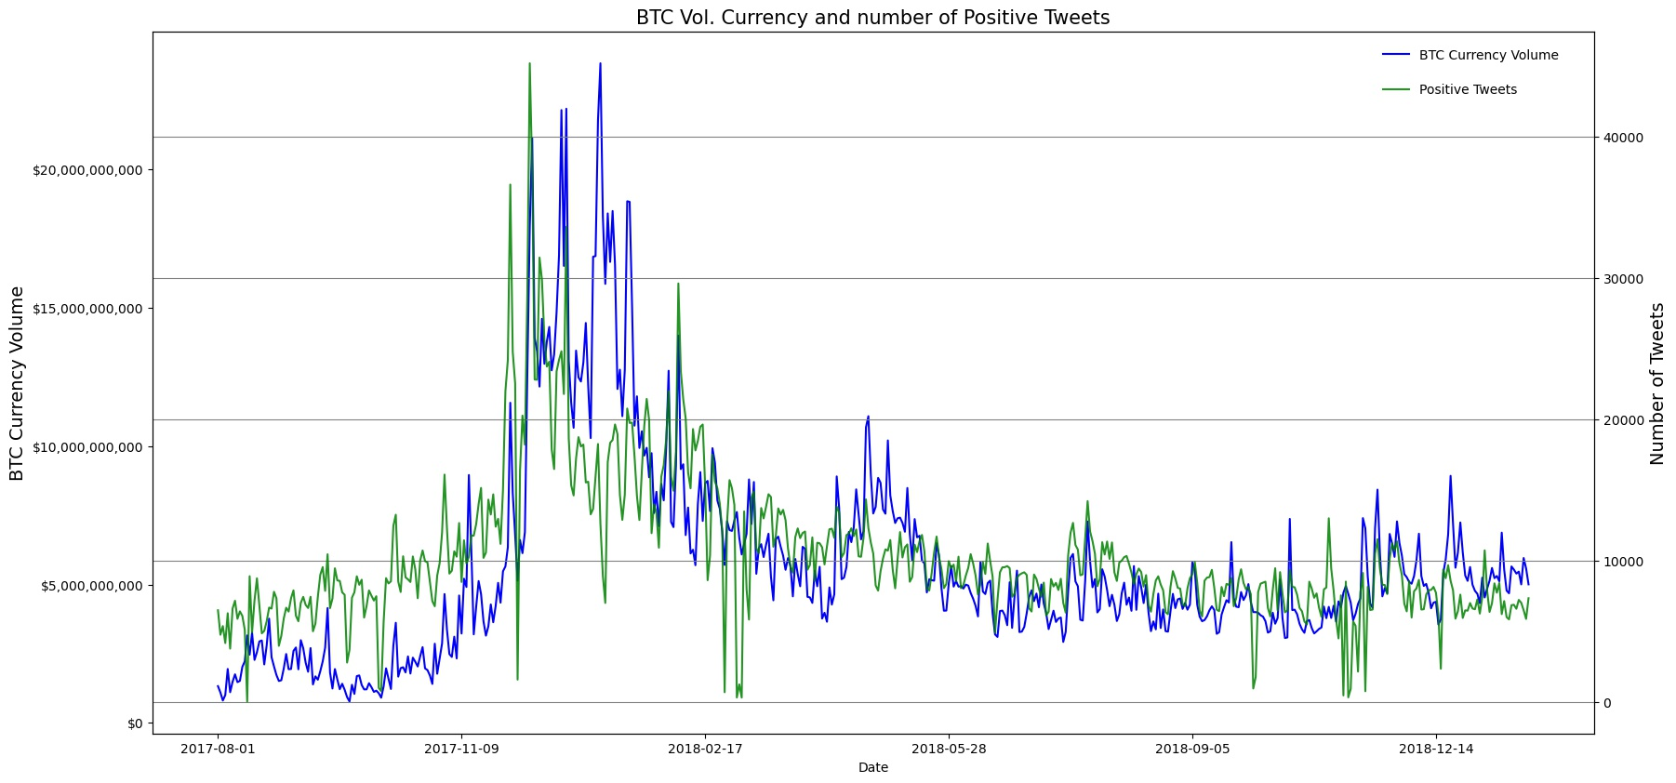
Bitcoin Volume and Positive Tweets
Correlation: 71%

Slide 16
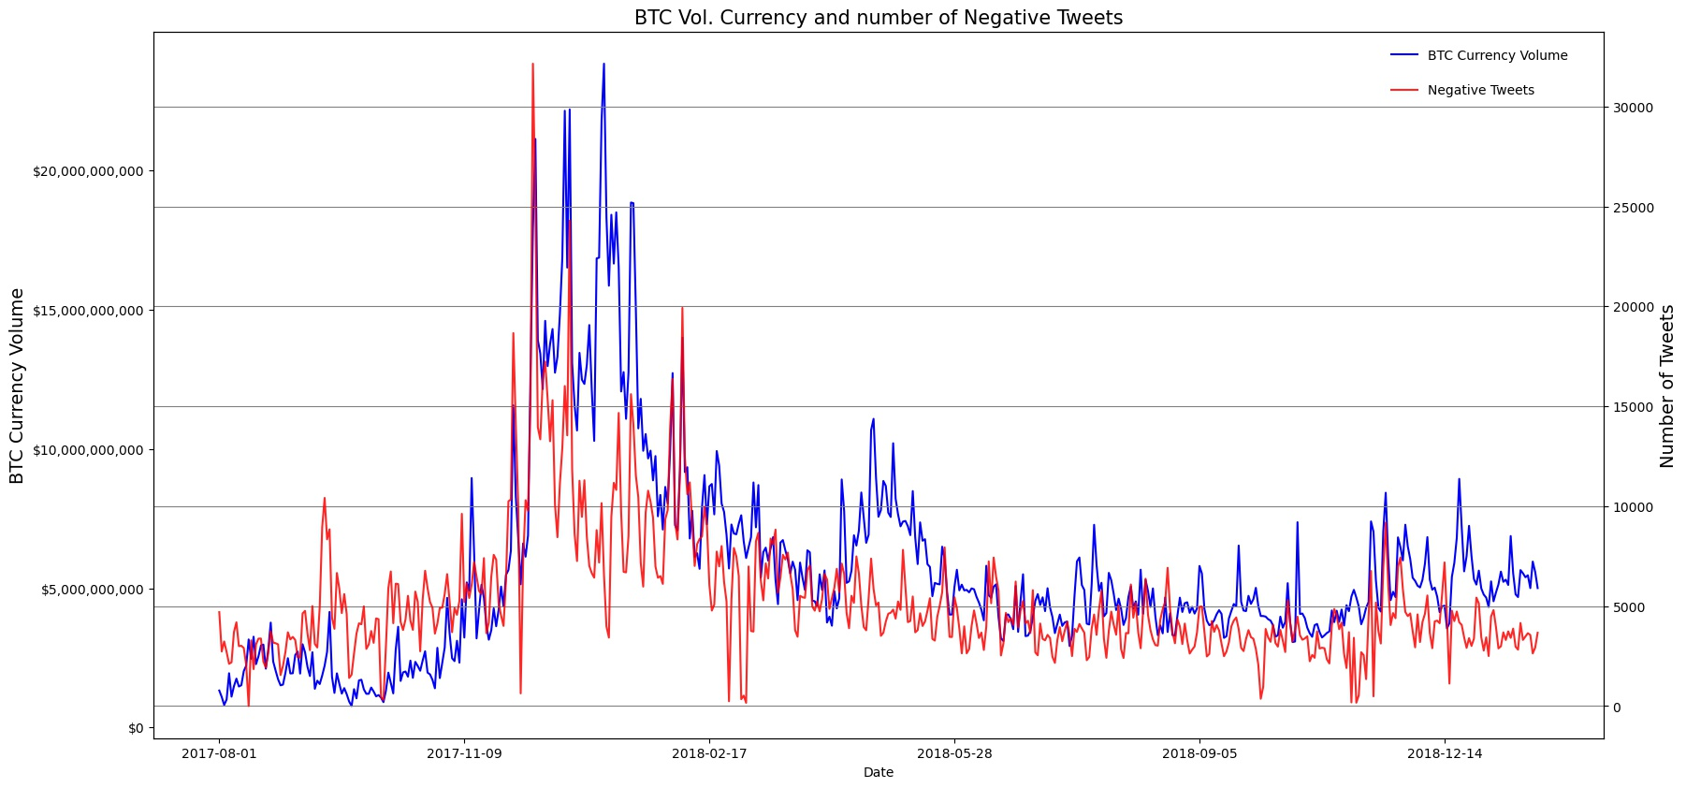
Bitcoin Volume and Negative Tweets
Correlation: 70%

Slide 17
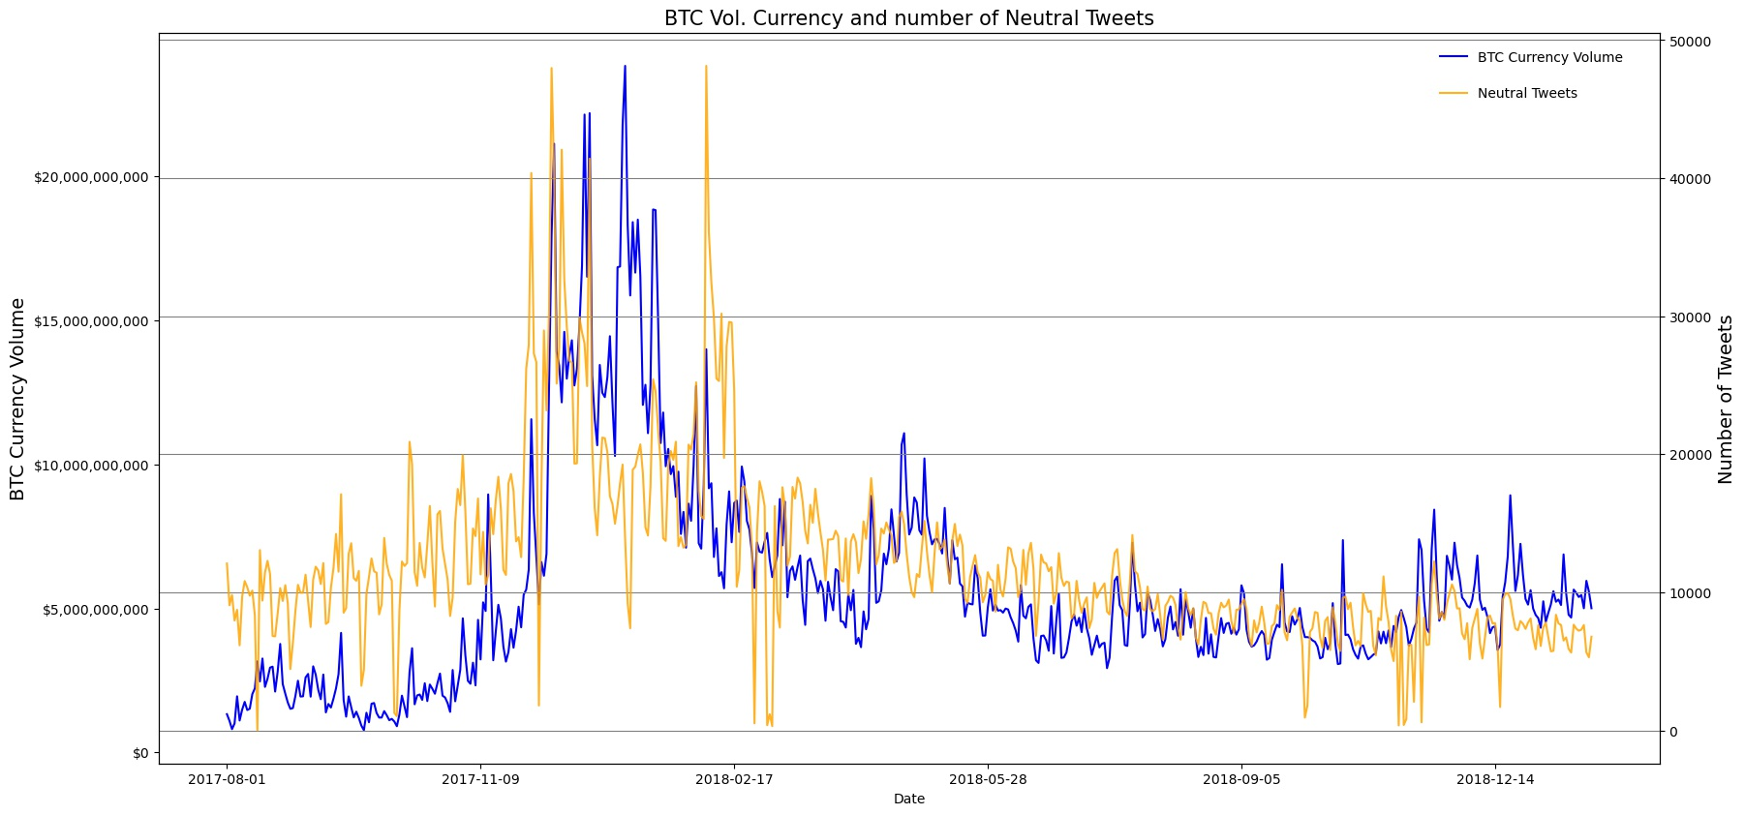
Bitcoin Volume and Neutral Tweets
Correlation: 61%

Slide 18
Correlation between tweets and BTC Volume ($)
 | Neutral Tweets | Positive Tweets | Negative Tweets
Correlation | 0.61 | 0.71 | 0.70

Slide 19
Regression Analysis: Tweet Sentiment impacts on Bitcoin Volume and Price

Slide 20
While we see correlations of 60-70%, running a regression can potentially show us the impact of tweets on bitcoin holding all else constant
Variable Setup
Model Specifications
Dependent Variables
Bitcoin Closing Price
Bitcoin Volume
Independent Variables
Positive Tweets
Negative Tweets
Neutral Tweets
Bitcoin Closing Price
Bitcoin Volume
Ordinary Least Squares (OLS) method
Log-Log model
Lagged Tweet and lagged dependent variables on each dependent variable
It’s appropriate to lag the Tweet variable by 1 day to help show that Tweets influence the Bitcoin price and/or volume sold

Slide 21
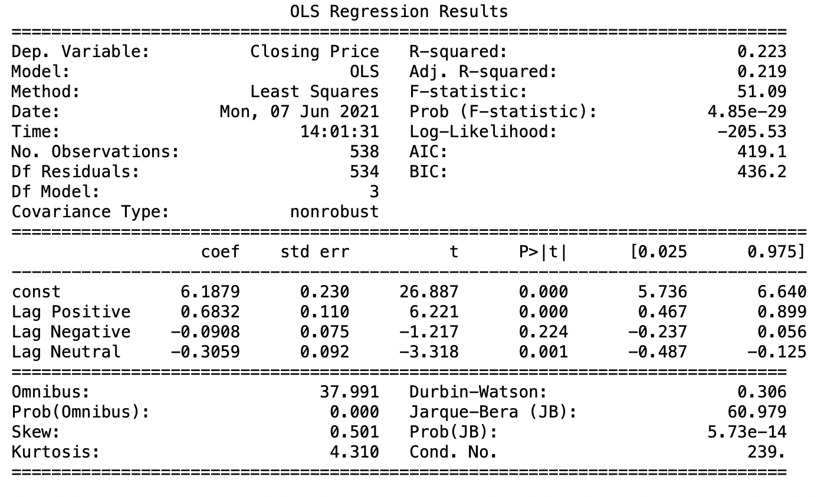
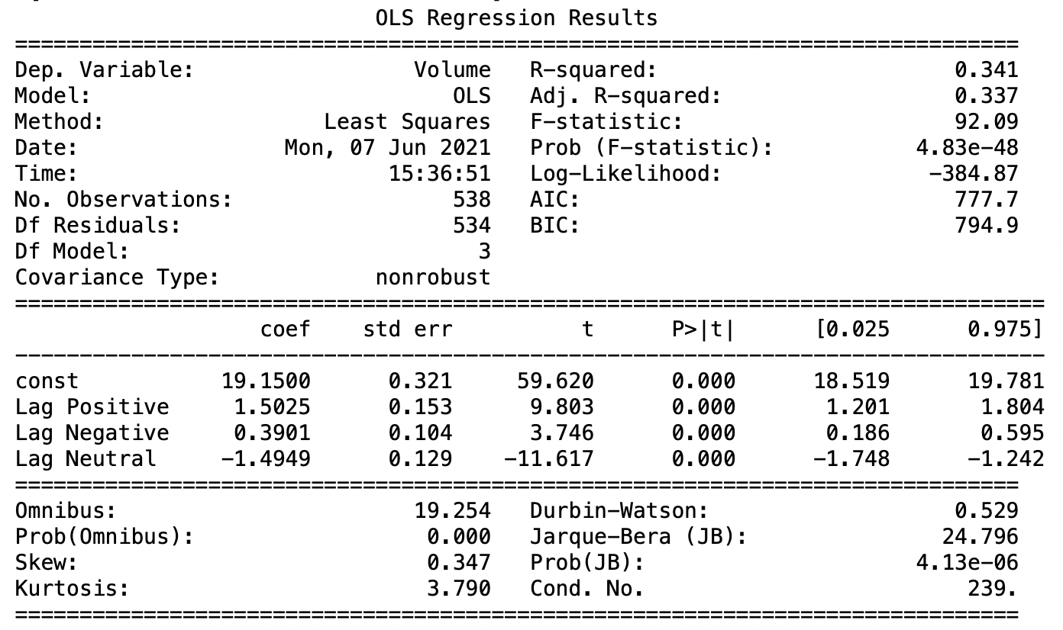
Running a only the sentiment variables on Closing Price and Volume yielded poor models with low explanatory value and autocorrelation. This indicates that we need to improve the model fit.
Sentiment impacts on Closing Price
Sentiment impacts on Volume

Slide 22
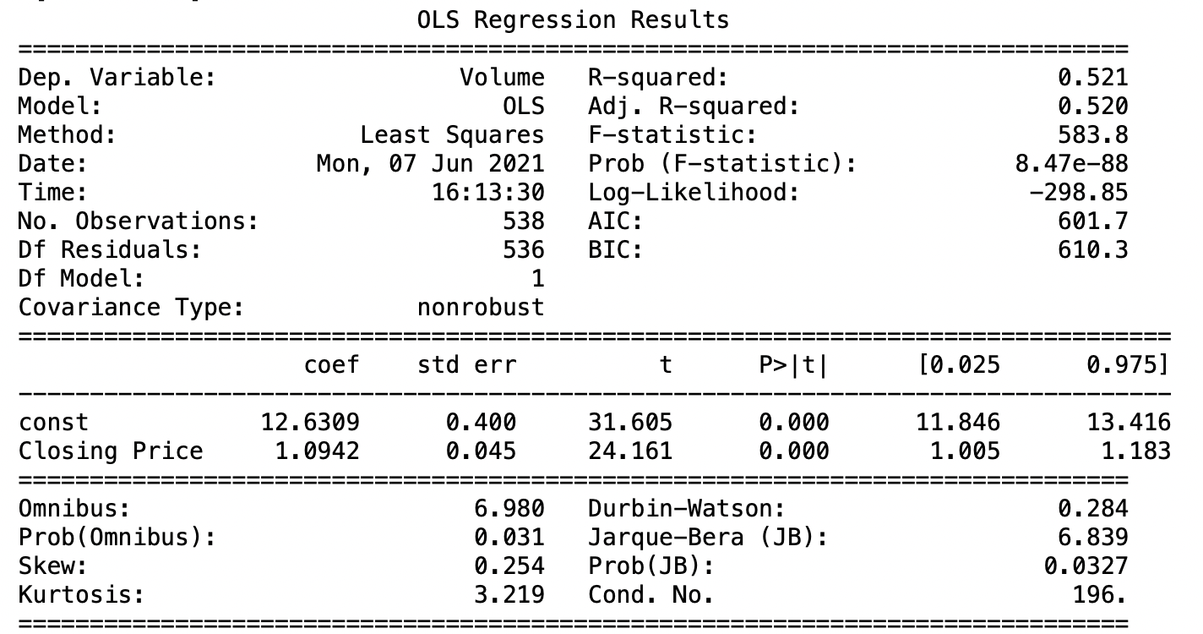
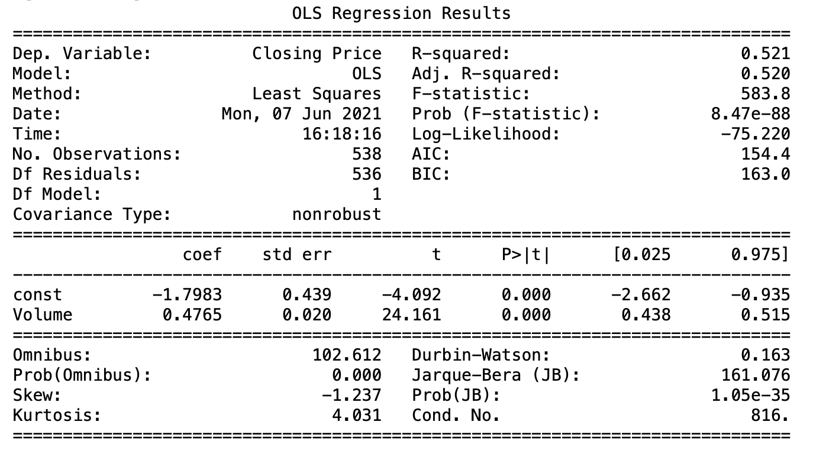
Similar to the correlation between Closing Price and Volume that we saw earlier, a regression helps us see the impact of Closing Price on Volume and vice-versa
Volume impact on Closing Price
Closing Price impact on Volume
Analysis: There is a correlation but there is an omitted variable bias
Analysis: There is a correlation but there is an omitted variable bias

Slide 23
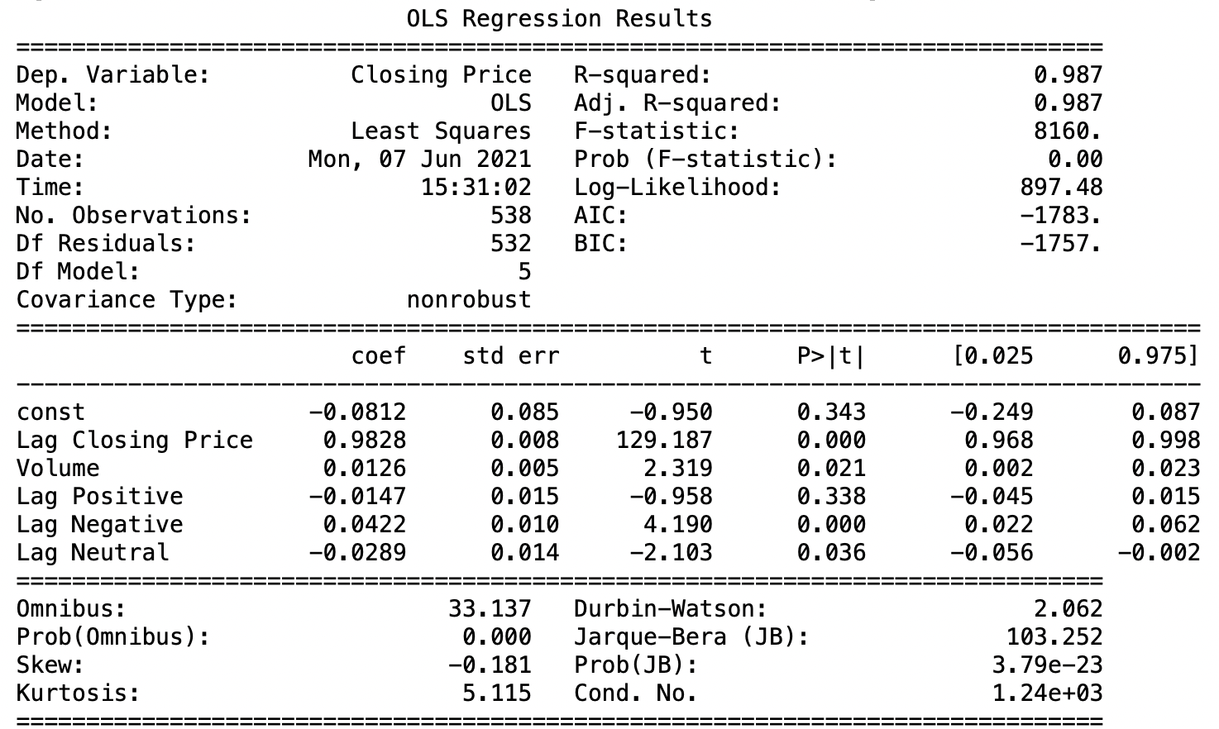
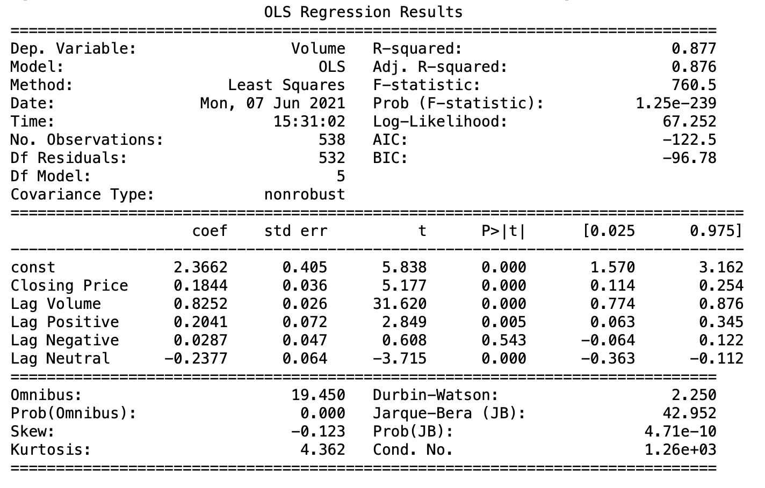
Final Model: Including a lag of the dependent variable helped stabilize the model
Sentiment, Volume and Lagged Closing Price impact on Closing Price
Sentiment, Closing Price, and Lagged Volume impact on Volume
Analysis: Negative and Neutral Tweets show significant impact but Negative having a positive impact on price is contrary to expectations
Analysis: Positive and Neutral Tweets show significant impact. For this analysis, it indicates that a 1% increase in positive tweets may lead to a 0.20% increase in bitcoin volume traded.

Slide 24
Conclusion

Slide 25
Conclusion
We see significant correlations of 60-70% for Twitter Tweet Sentiments (Positive, Negative, and Neutral) on Bitcoin Price and Bitcoin Volume
Running an OLS log-log regression analysis, we see inconclusive results for Twitter Sentiments on Bitcoin Price. However, we do see some evidence for positive tweets having a positive impact on Bitcoin Volume and neutral tweets having a negative impact on Bitcoin Volume. However, we note there are limits to our model including a potential omitted variable bias.

Slide 26
References

Slide 27
References
References
[1]” Bitcoin 17.7 million Tweets and price. Bitcoin Tweets sentiment analysis and the price”, https://www.kaggle.com, 2019. [Online]. Available: https://www.kaggle.com/jaimebadiola/bitcoin-tweets-and-price. [2]” Bitcoin Data from 2014 to 2020”, https://www.kaggle.com, 2020. [Online]. Available: https://www.kaggle.com/khalilbrick/bitcoin-data-from-2014-to-2020

